Slide 1
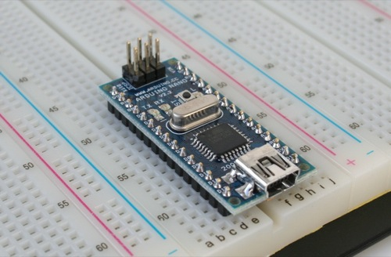
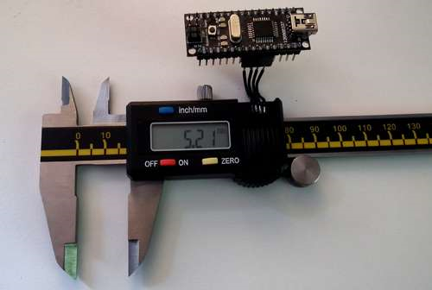
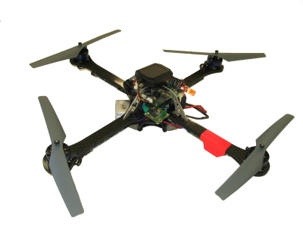
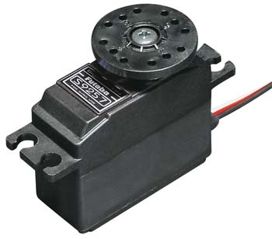
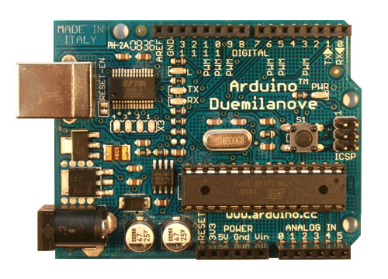
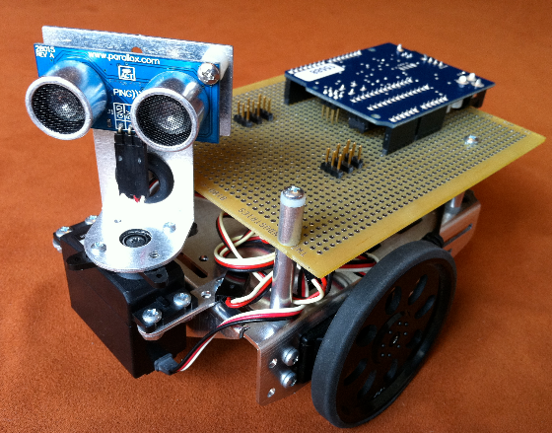
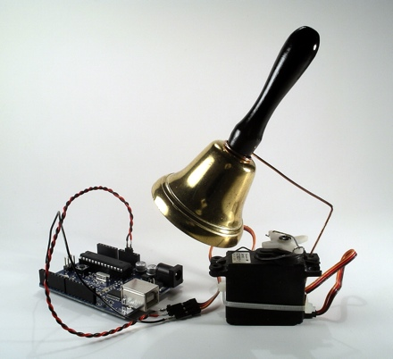
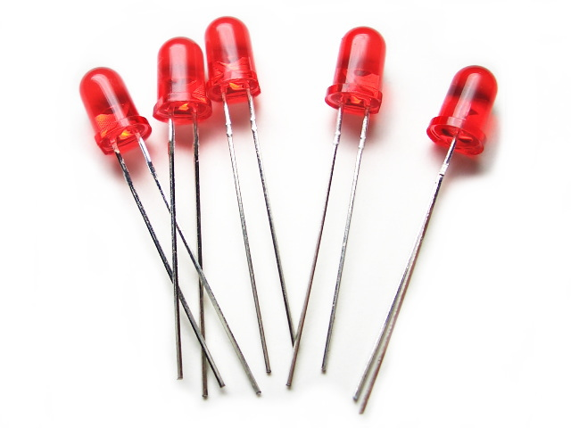
Intro to Arduino
Marc Lichtman

Slide 2
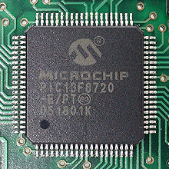
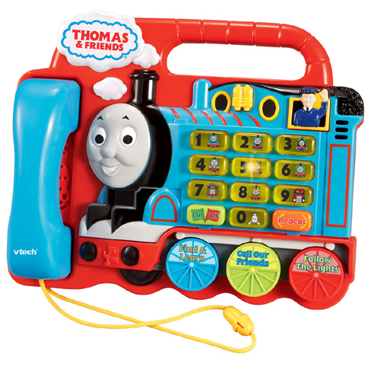
What is a Microcontroller?
Single integrated circuit (chip)
  Processor
  Memory
  Peripherals
Used in automatically controlled devices
  Appliances
  Remote controls
  Power tools
  Toys
Very inexpensive

Slide 3
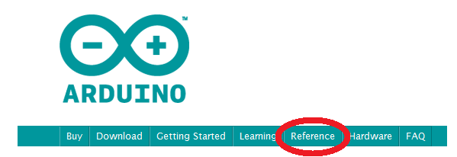
Software
Arduino → C++ → Assembly

Slide 4
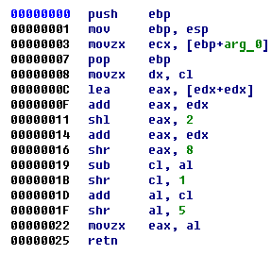
Assembly

Slide 5
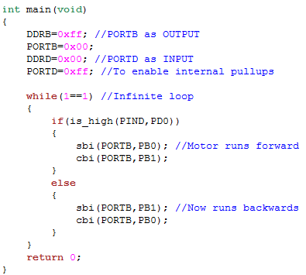
C++

Slide 6
Arduino
int ledPin = 13; // LED connected to digital pin 13
void setup()
{
pinMode(ledPin, OUTPUT); // sets the digital pin as output
}
void loop()
{
digitalWrite(ledPin, HIGH); // sets the LED on
delay(1000); // waits for a second
digitalWrite(ledPin, LOW); // sets the LED off
delay(1000); // waits for a second
}

Slide 7
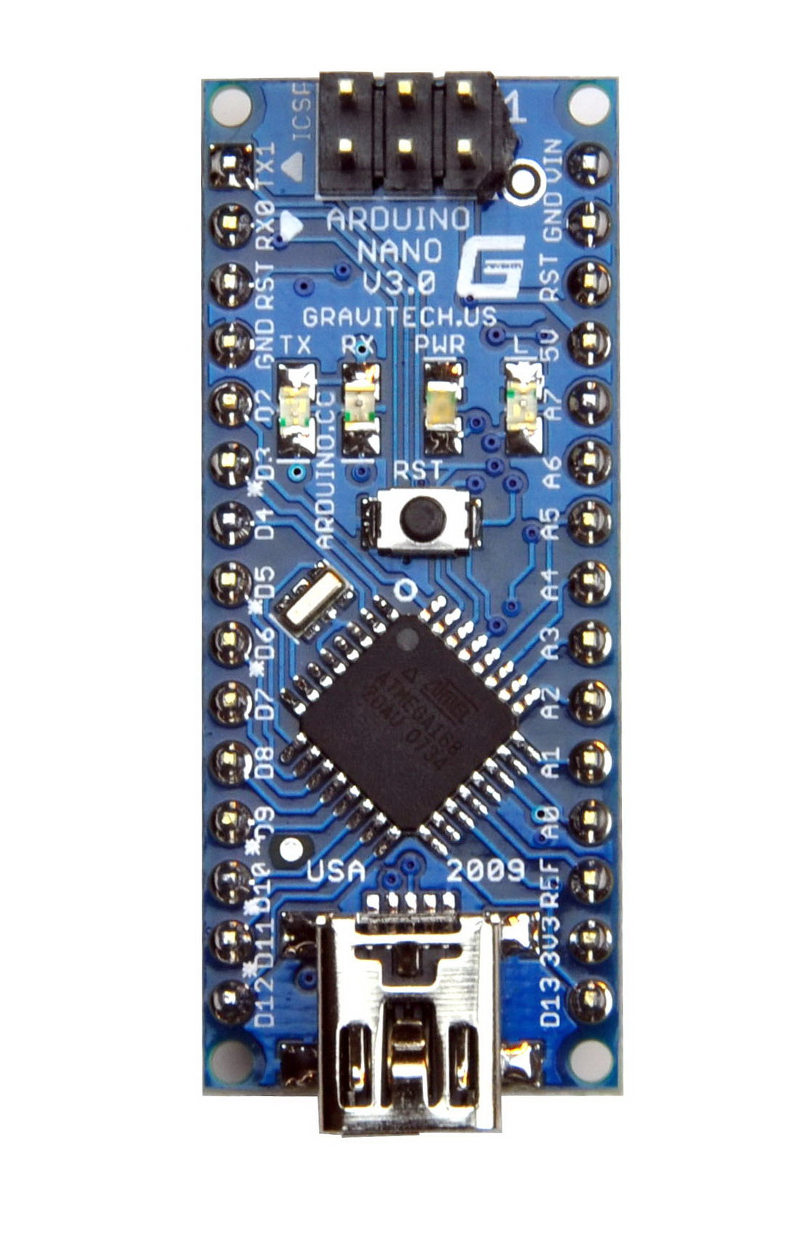

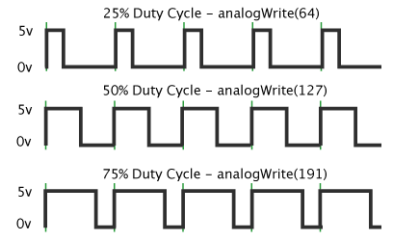
Hardware
Microcontroller (Atmel ATmega328)
Digital input and output pins (14)
Analog input pins (8)
PWM (6)
Flash Memory (32 KB)
Clock Speed (16 MHz)
USB connectivity

Slide 8
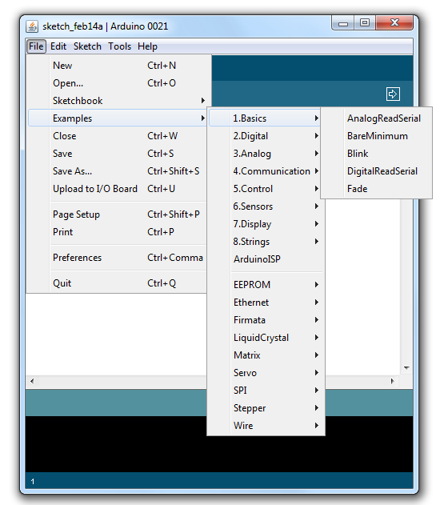
Lab
Load Blink program (see screenshot below)
2. Experiment with Serial communication using the code below
Serial.begin(9600); //this line goes in setup function, and configures serial
Serial.print(“Hello World"); // sends text to the serial monitor
Serial.println(“Hello World”); // prints as a new line
Turn your Arduino into a 4 function calculator

